Slide 1

“BMI AND DIET”
PRESENTED BY:
SURAJ SHINDE ( T150884321)
SHUBHAM GOUR (T150884326)
SWAPNIL WADGAVE(T150884343)
SIDHARAM YALASANGI(T150884345)
Third Year Semester-I A.Y. 2018-19
GUIDED BY Prof. ASHWINI NAVALE
Dr. D.Y.PATIL SCHOOL OF ENGINEERING,PUNE
Department of Computer Engineering

Slide 2
INDEX
Abstract (Problem statement)
Introduction(Motivation, Objectives, Goals)
Requirement Analysis(H/W,S/W)
System Design(Architecture, Flow of working, UML Diagrams)
Scope of Project(Pros and Cons)
Results(Tables, Screen Shots, Database)
Conclusion

Slide 3
ABSTRACT
The dietician is an application about human diets. It acts as a diet consultant similar to a real dietician. This system acts in a similar way as that of a dietician. A person in order to know its diet plan needs to give some information to the dietician such as its body type, weight, height and its working hour details. Similar way this system also provides the diet plan according to the information entered by the user. The system asks all this data from the user and processes it to provide the diet plan to the user.

Slide 4
INTRODUCTION
In the Android app system, you have to hire a dietician in order to get advice. Hiring a nutrition doctor will not only waste your time and efforts for calling them, going to them and so on but also cost you very high as their charges per month are very high. The moment will also arrives when they will not available for you and you have to search for some other dietician urgently. So we have develop android application.

Slide 5
Objective
The objective of this project is to suggests diet plan based on user’s height, weight and eating habits. The system measures a user’s body mass index using his/her height and weight. The system has been trained with large dataset of food varieties and their nutritional values. Once the system has the user’s body mass index, it needs to know eating habit of the user. The user has to provide information about the timings he eats. Timings for breakfast, lunch, snacks and dinner are entered by the user. Once the system has this data, it suggests the user a diet plan as per the user’s body mass index.

Slide 6
Requirement Analysis
Hardware Requirement
Processor: i3 or above
RAM: 4 GB or above
Android device
Software Requirement
Windows 7 or above
JDK
ANDROID STUDIO
SDK
SQLite

Slide 7
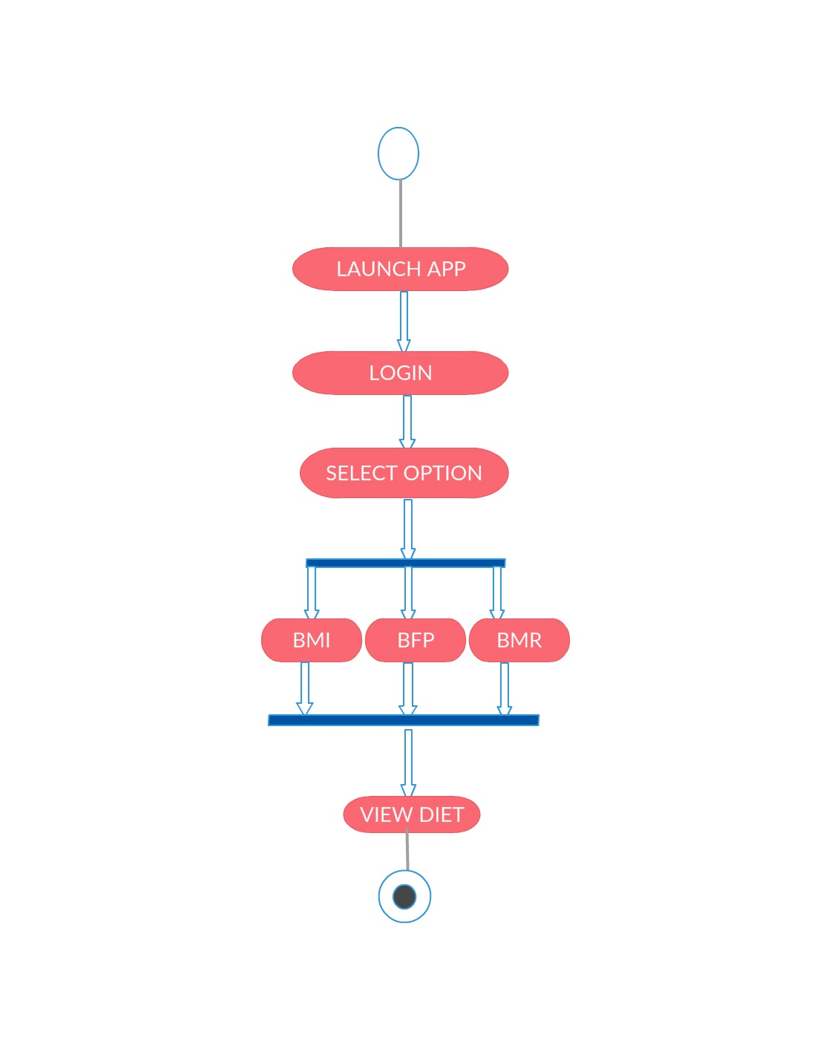
SYSTEM DESIGN
--System Architecture

Slide 8
BODY MASS INDEX
Metric BMI Formula
BMI = weight ÷ height²

Slide 9
BASAL METABOLIC RATE
1. Calculate your BMR (basal metabolic rate):
Women: BMR = 655 + ( 4.35 x weight in pounds ) + ( 4.7 x height in inches ) - ( 4.7 x age in years )
Men: BMR = 66 + ( 6.23 x weight in pounds ) + ( 12.7 x height in inches ) - ( 6.8 x age in years )
2. Multiply your BMR by the appropriate activity factor, as follows:
Sedentary (little or no exercise): BMR x 1.2
Lightly active (light exercise/sports 1-3 days/week): BMR x 1.375
Moderately active (moderate exercise/sports 3-5 days/week): BMR x 1.55
Very active (hard exercise/sports 6-7 days a week): BMR x 1.725
Extra active (very hard exercise/sports & physical job or 2x training): BMR x 1.9
3. Your final number is the approximate number of calories you need each day to maintain your weight.

Slide 10
BODY FAT PERCENTAGE
Body fat percentage (BFP) formula for males:
USC Units:
BFP = 86.010×log10(abdomen-neck) - 70.041×log10(height) + 36.76
SI, Metric Units:
BFP =
495
1.0324 - 0.19077×log10(waist-neck) ) + 0.15456×log10(height)
- 450
Body fat percentage (BFP) formula for females:
USC Units:
BFP = 163.205×log10(waist+hip-neck) - 97.684×(log10(height)) + 36.76
SI, Metric Units:
BFP =
495
1.29579 - 0.35004×log10(waist+hip-neck) + 0.22100×log10(height)
- 450

Slide 11
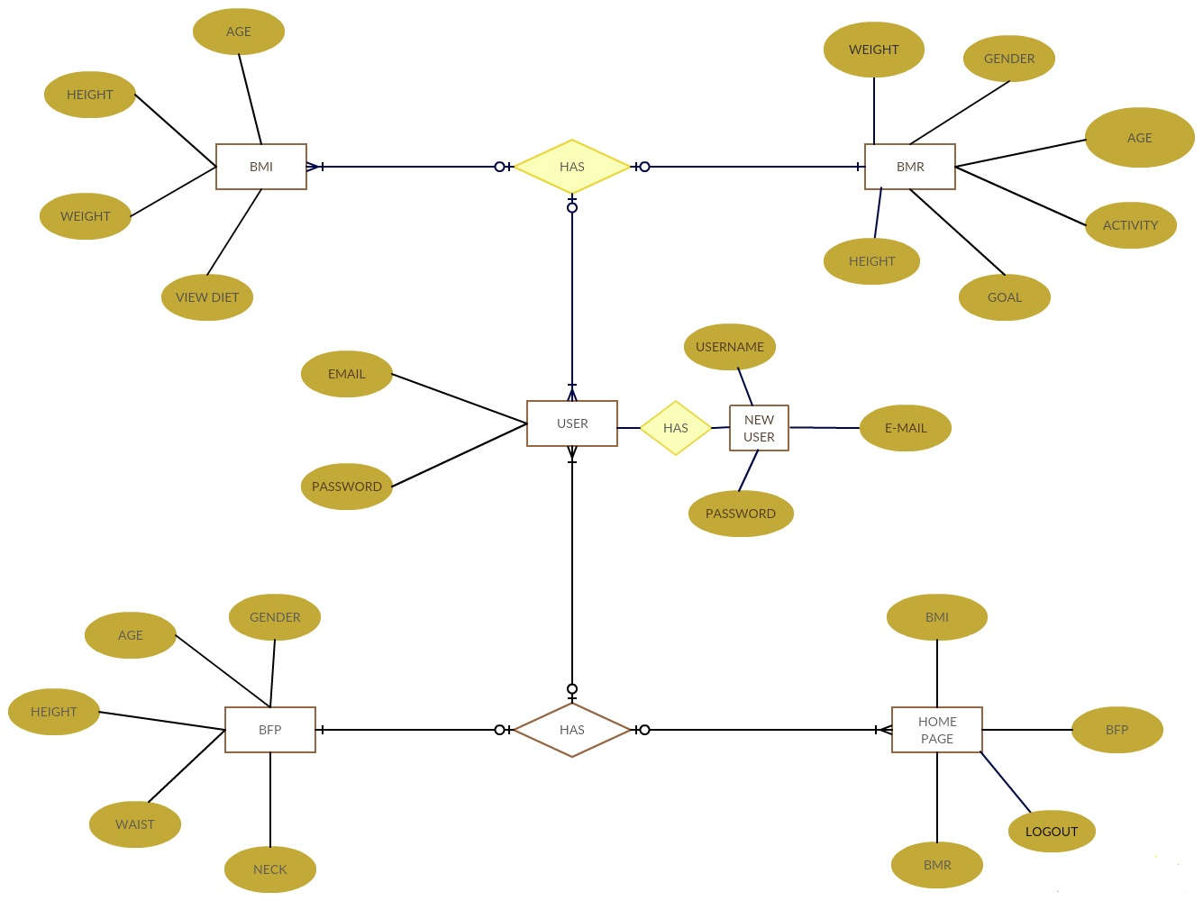
ER-DIAGRAM

Slide 12
Advantages:
The application also eliminates the travelling cost in visiting a dietician.
The usage of this application greatly reduces the time required to get the best diet plan as it is standalone application and there is no danger of one point failure
Disadvantages:
The android mobile user will not be able to insert or view details if the database goes down. Thus there is disadvantage of single point failure.

Slide 13
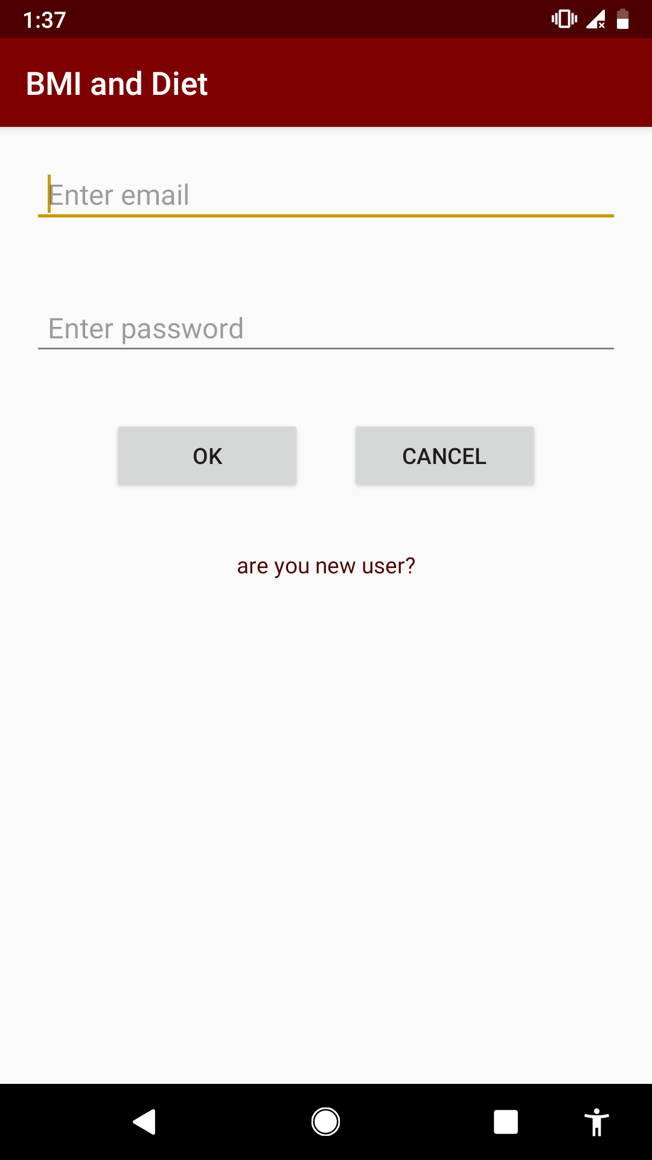

Slide 14
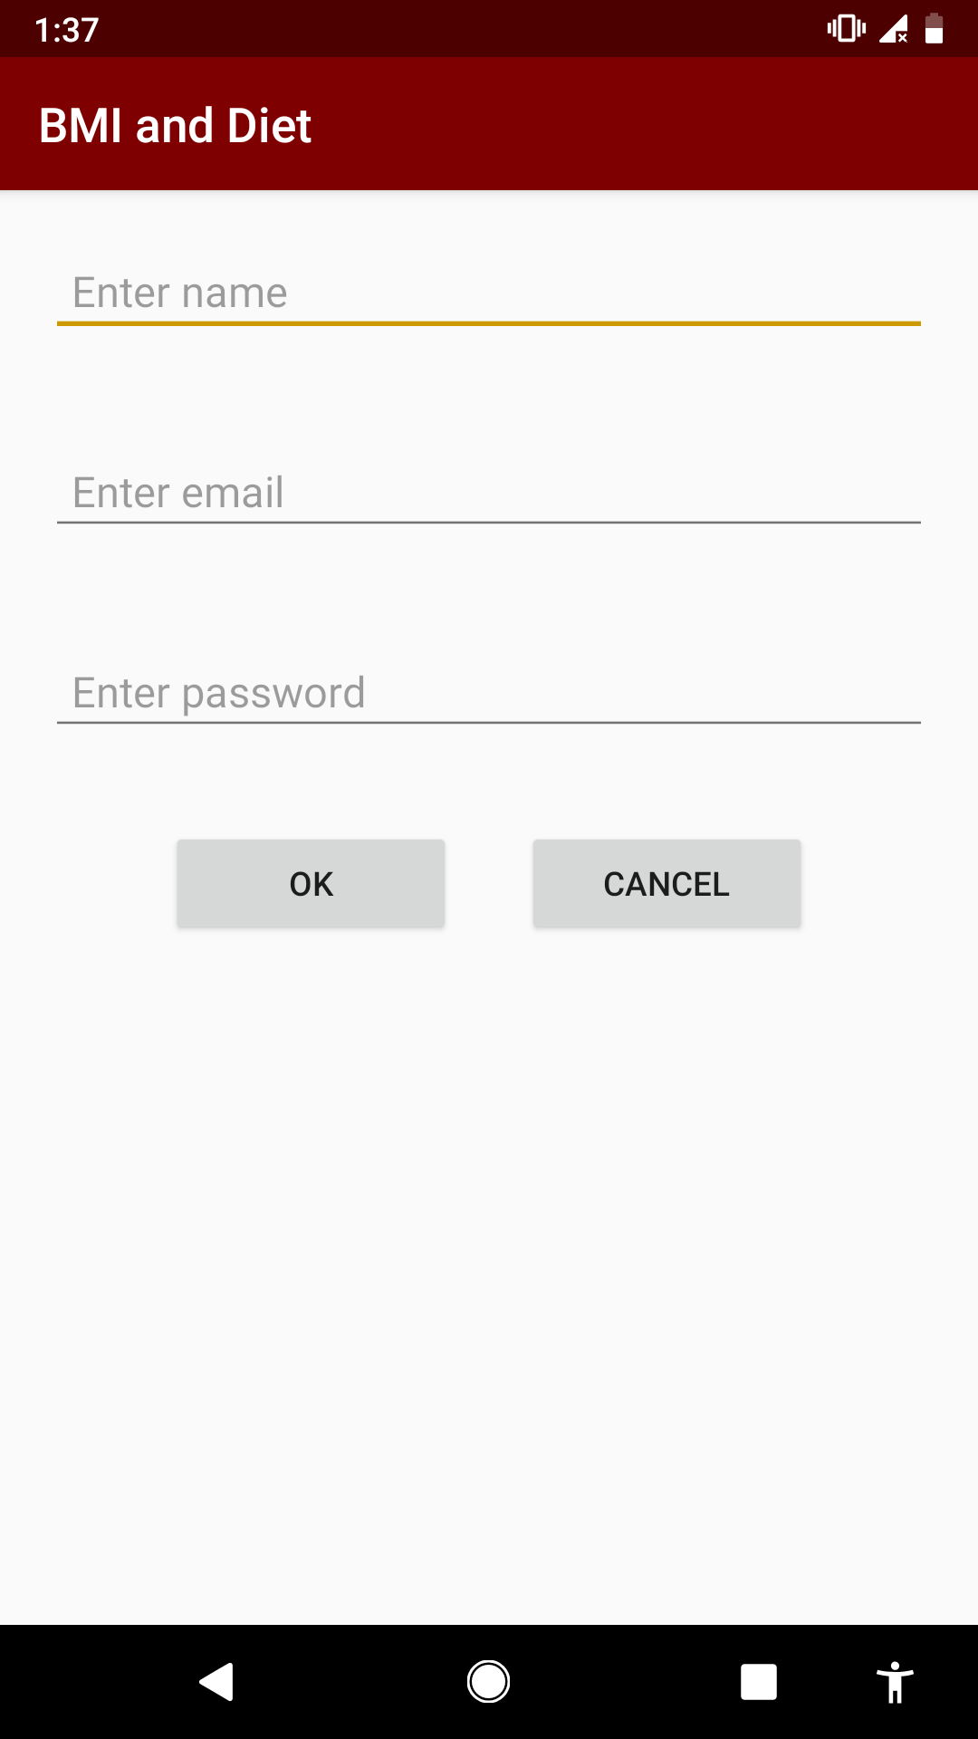
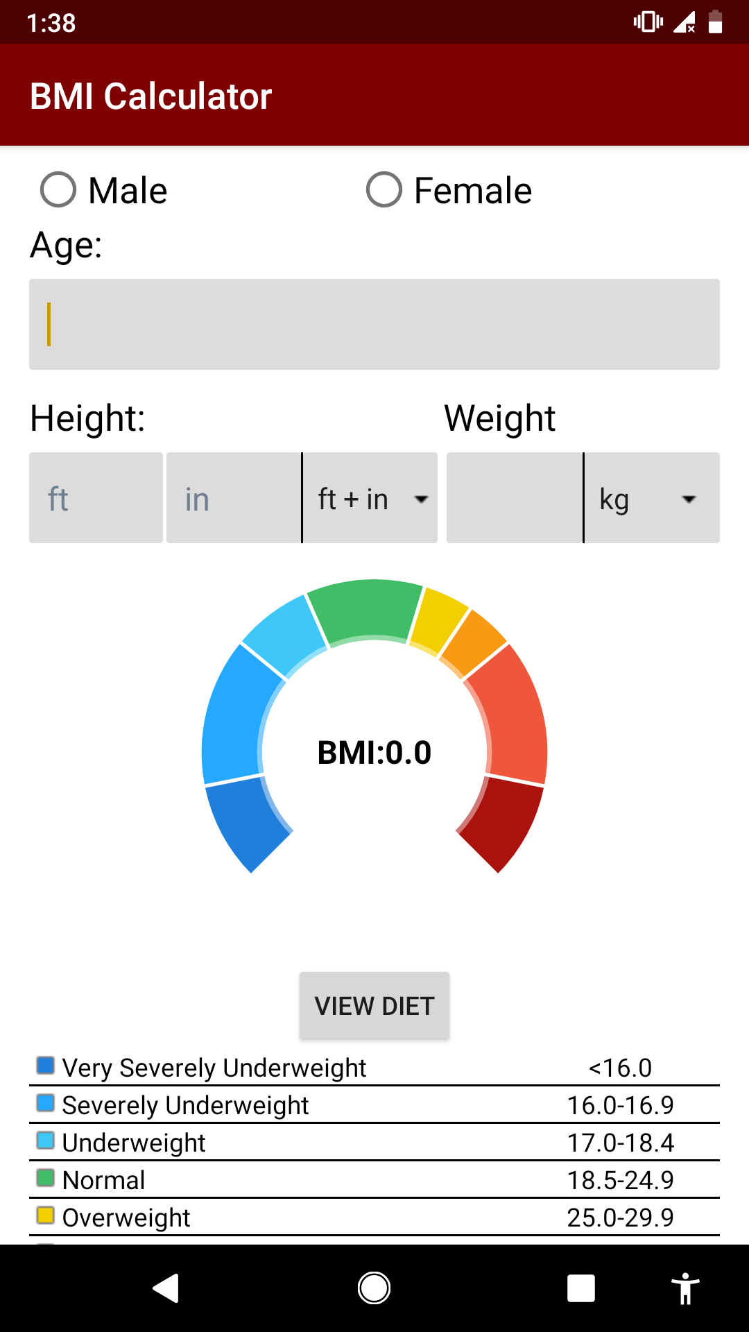

Slide 15
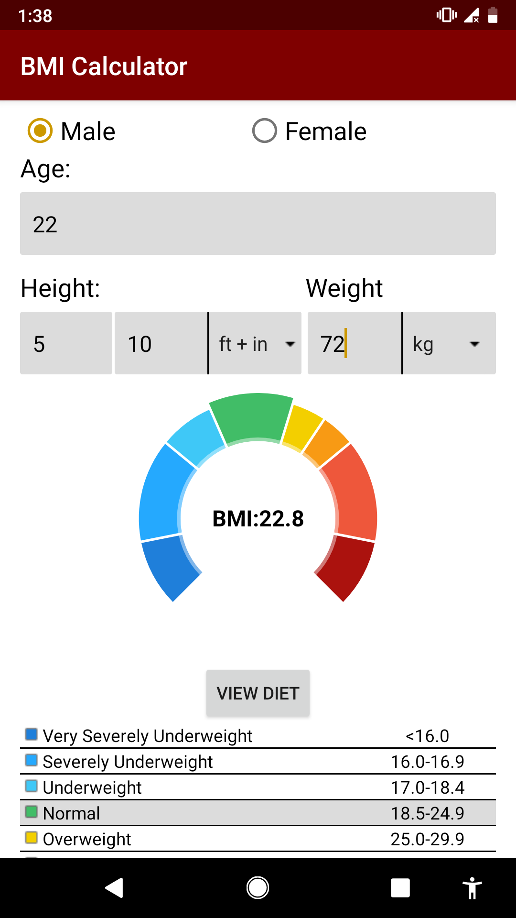

Slide 16
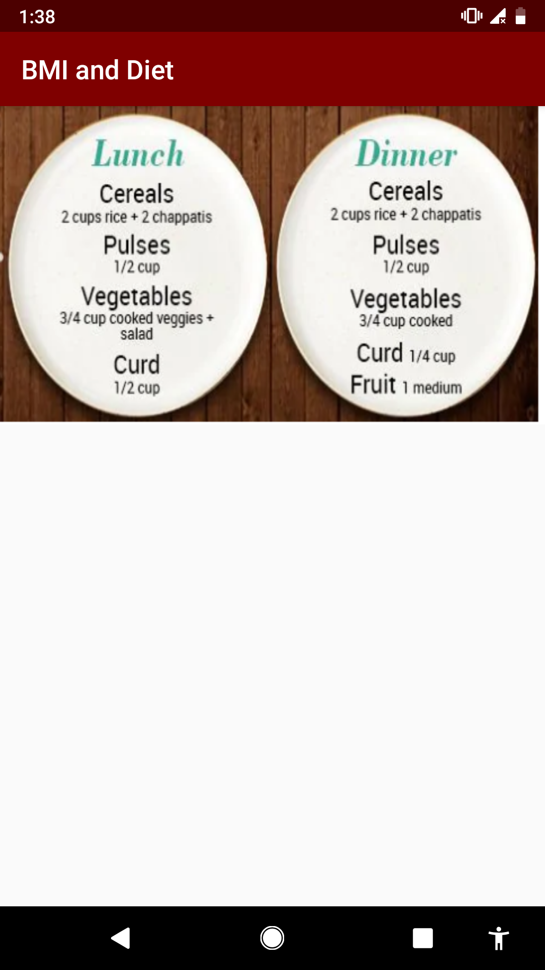

Slide 17
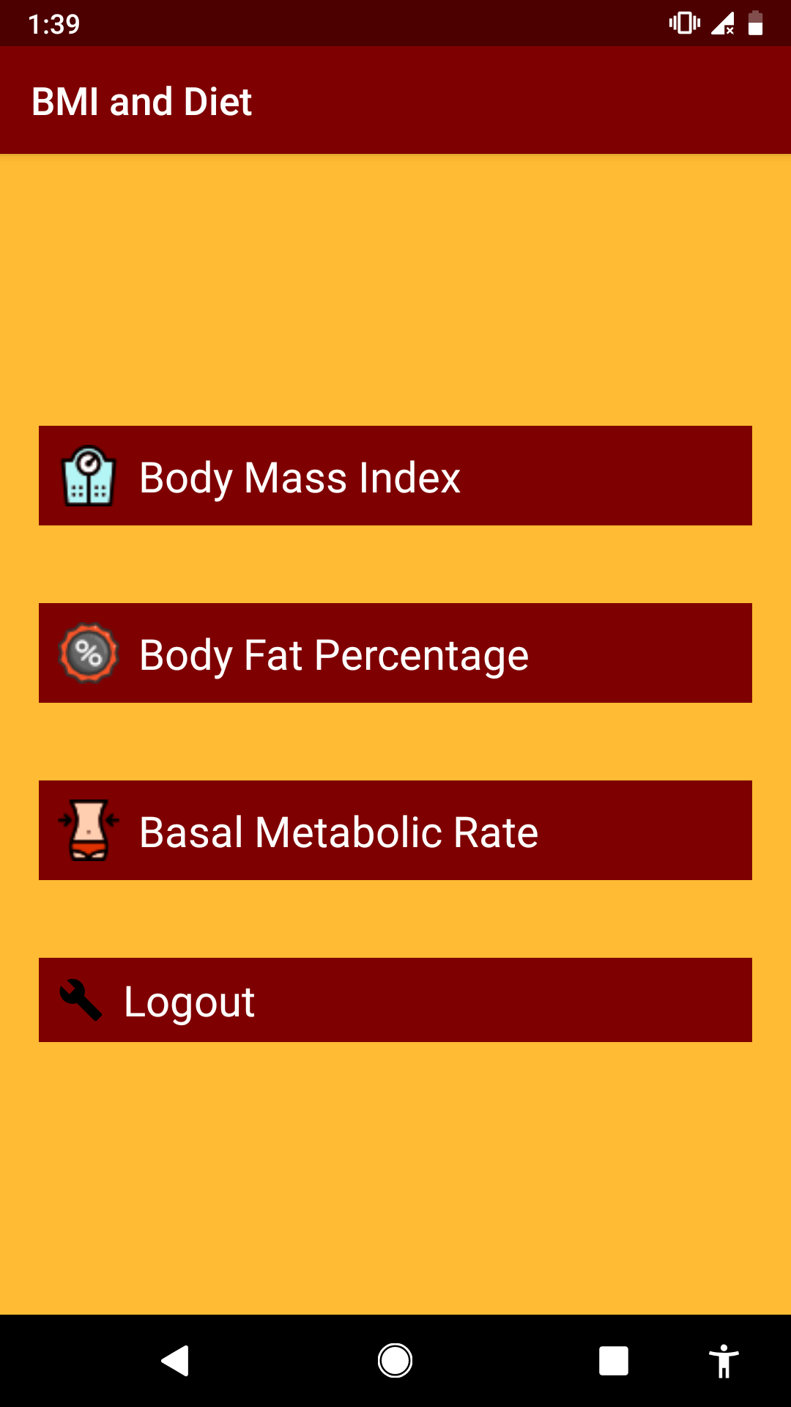

Slide 18
CONCLUSION
Thus we have implemented an DIET APP based on ANDROID . The app will give more accurate results as it accepts the data entered by the user and processes it depending on some metrics already known to the application on the basis of which a diet plan is generated.

